Slide 1
Tuck Everlasting Lesson Plan
Language Arts, Grade 6

Slide 2
LEARNING OUTCOMES
Students will engage in close reading to learn how people lived in the late 19th Century.
Students will visualize a main character in a text.
Students will create an in-depth dialogue between two people, using details from the text.

Slide 3
COMMON CORE STANDARDS
CCSS.ELA-LITERACY.RL.6.1 Cite textual evidence to support analysis of what the text says explicitly as well as inferences drawn from the text.
CCSS.ELA-LITERACY.W.6.3.B Use narrative techniques, such as dialogue, pacing, and description, to develop experiences, events, and/or characters.
CCSS.ELA-LITERACY.W.6.3.D Use precise words and phrases, relevant descriptive details, and sensory language to convey experiences and events.

Slide 4
materials
Student computers with internet access
www.readwritethink.org website
Flash player installed for Doodle Splash
Classroom set of Tuck Everlasting

Slide 5
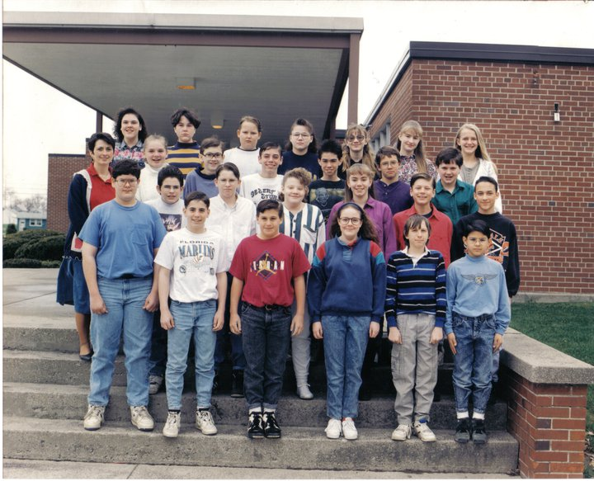
Activity #1: Brainstorm
All of you dress very differently from your parents and your grandparents. In your opinion, what types of clothing have gone out of style?
Show old yearbook photos of some of the current middle school teachers. Discuss differences in clothing, hair styles, makeup, etc.

Slide 6
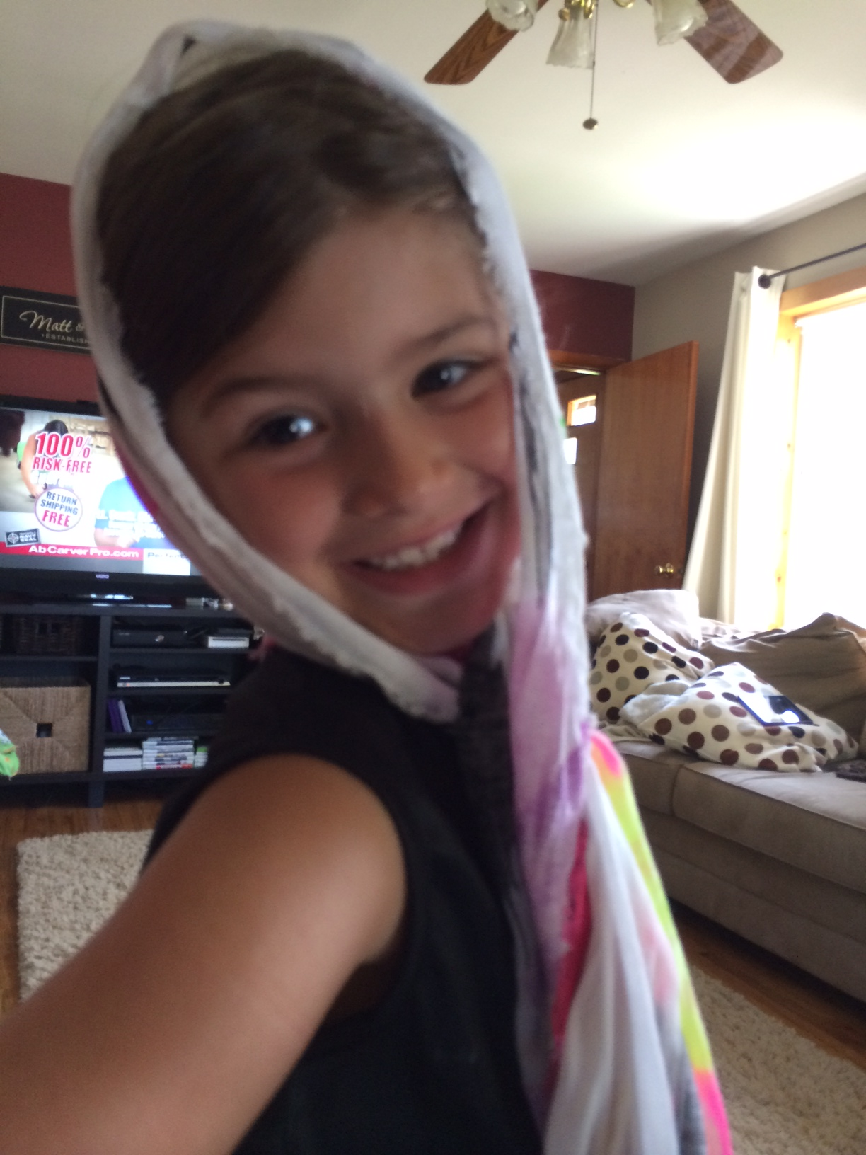
Student examples: What Did people wear in the past?
1600s
Big hats that covered their hair (unlike now)
Buckles on their hats and pants
1700s:
“Men wore wigs and war clothes”
1980s:
“Tuxedos” “Men’s short shorts “Shirts tucked into shorts”
Not sure:
“High collars” “Bonnets”

Slide 7
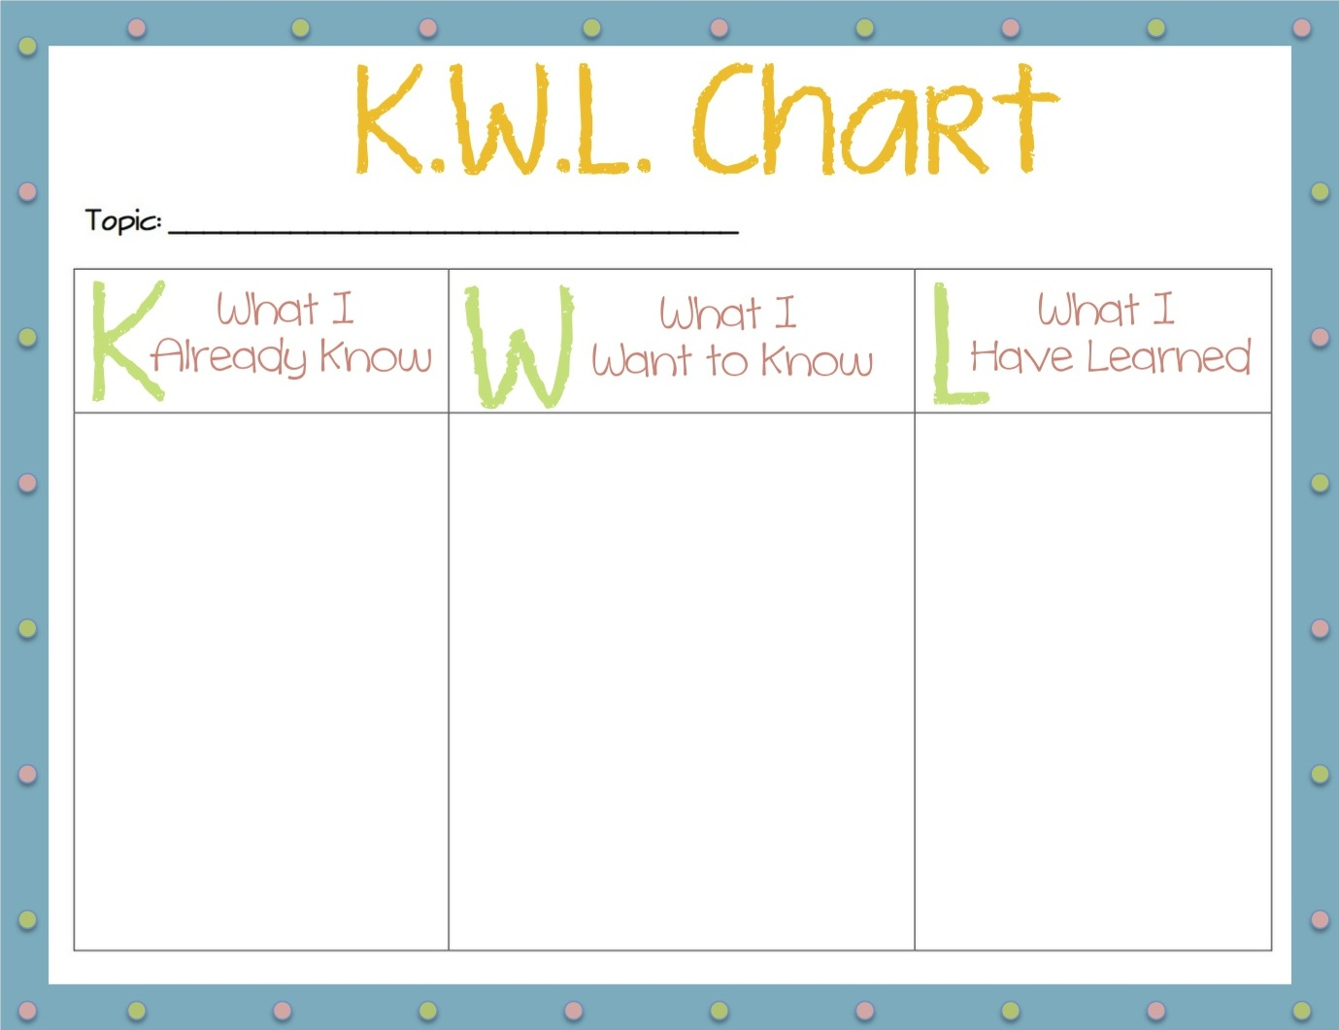
Activity #3: K/W/L Chart
K- Describe life in the late 19th Century.
W- (What you want to know about this time period)
L- (What you learned about life in the late 19th Century after reading Tuck Everlasting)
http://www.readwritethink.org/classroom-resources/student-interactives/creator-30846.html

Slide 8
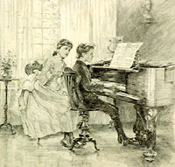
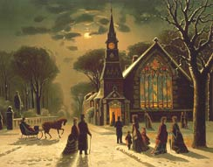
Activity #4: purpose for reading
As you read Tuck Everlasting, pay particular attention to details about life during the late 19th Century.
Look for clues about dress, transportation, homes, occupations, etc. Take detailed notes.
Images from the Library of Congress

Slide 9
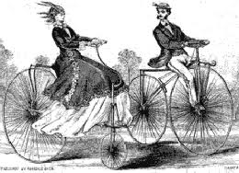
Activity #2: Discussion
Use students’ examples to flesh out the time periods that students attach to the clothing.
Discuss why people dressed differently in different time periods. (Ex: gender roles)
Guide them towards the late 19th Century time period.

Slide 10
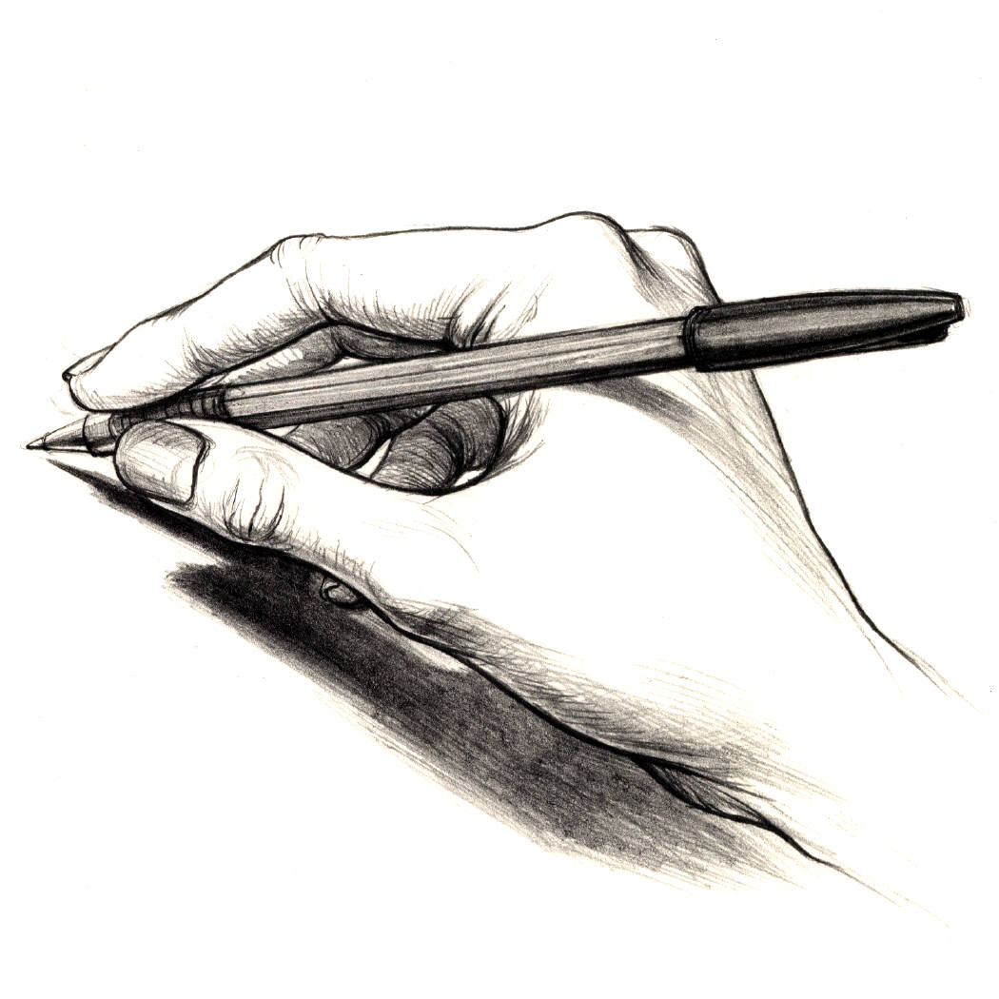
Activity #5: using text details to draw conclusions
What do you think Winnie Foster would have worn? Look back at your notes for ideas.
Log on to a computer and draw your interpretation using the Doodle Splash interactive
http://www.readwritethink.org/classroom-resources/student-interactives/doodle-splash-30022.html

Slide 11
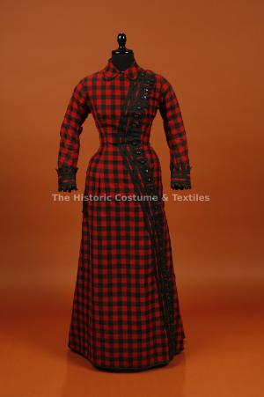
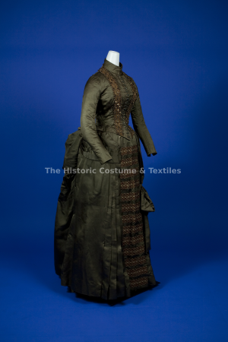
Activity #6: Fashion2fiber
Use the 1880’s examples to show students how accurate their drawings were. Discuss differences between student designs and actual primary sources from that time period.
Black and red wool plaid bustle dress
Red embroidery cotton corset
Olive brown dress
Green wool bodice and skirt
Yellow Lyons silk brocade bustle dress

Slide 12
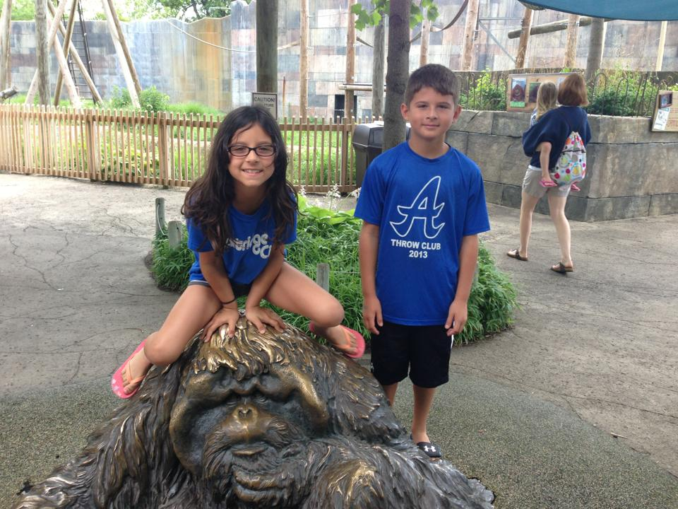
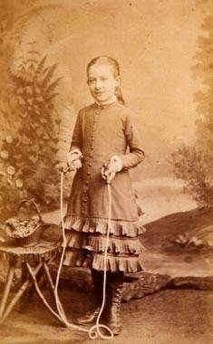
Assessment: Writing assignment
What would Winnie Foster think about today’s world? What would she say about your clothes? Your hairstyle? Your hobbies?
Create a dialogue between yourself and Winnie Foster. Be true to who Winnie was and how she felt about her life in the late 19th Century.

