Slide 1
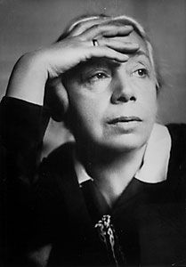
Kathe Kollwitz The Human Cost of War Response to World War I
PowerPoint © Catherine Means, 2010

Slide 2
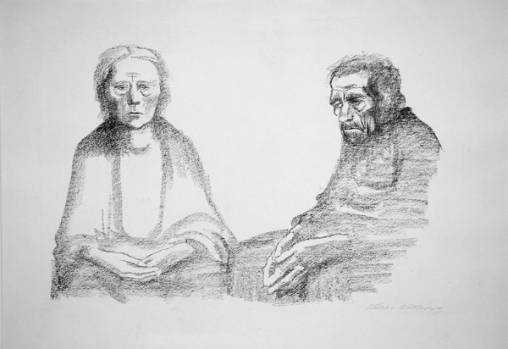
“The Artist’s Parents” -1919

Slide 3
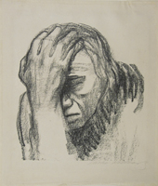
“Pensive Woman” -1920

Slide 4
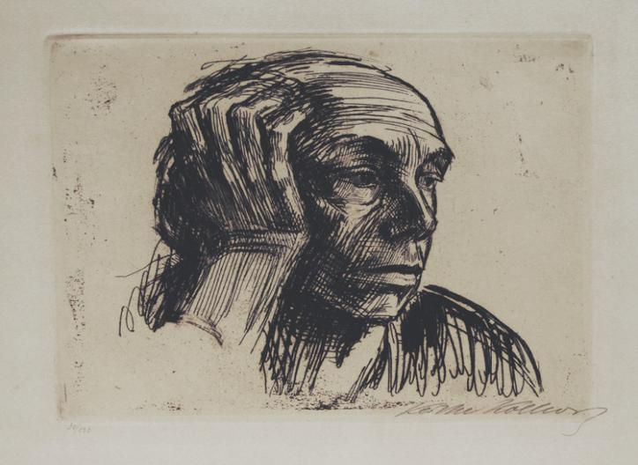
Self Portrait -1921

Slide 5
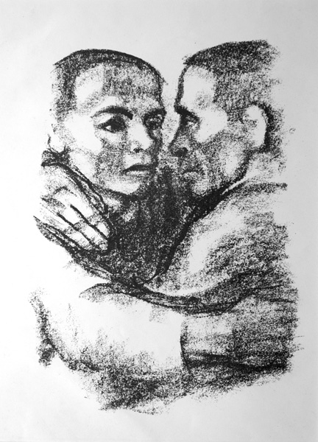
“Fraternal Love” -1924

Slide 6
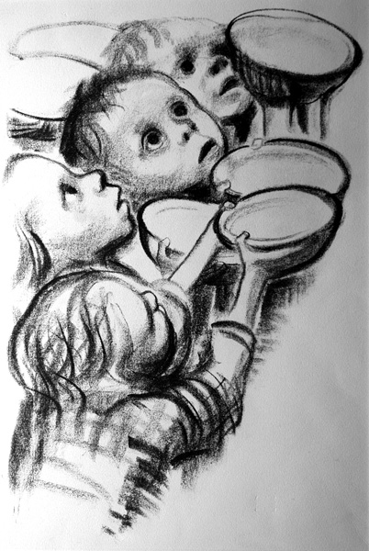
“Germany’s Children Are Starving” -1924

Slide 7
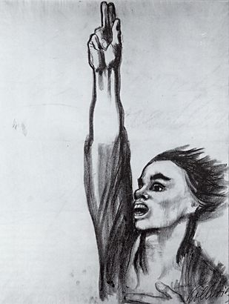
“Never Again War” -1924

Slide 8
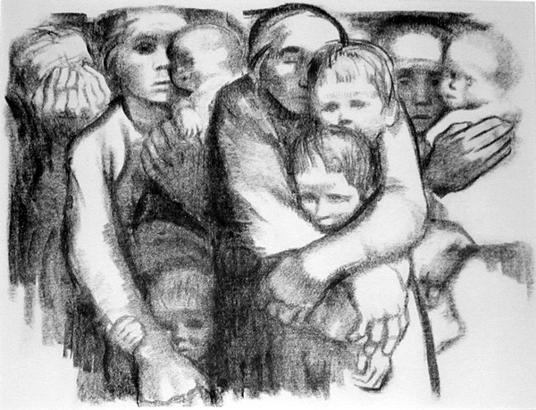
“Mothers” 1931

Slide 9
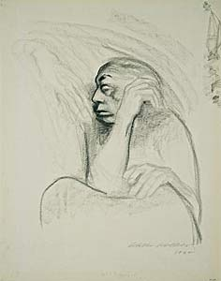
“Self Portrait” -1934

Slide 10
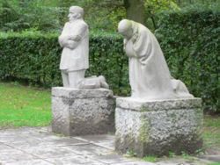
“The Grieving Parents” Monument faces the cemetery where her son is buried.

