Slide 1
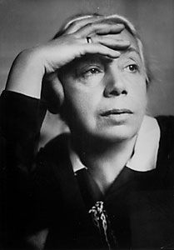
Kathe Kollwitz “Champion for the rights of the underprivileged”
PowerPoint © Catherine Means, 2010

Slide 2
Early Life
Born July 8, 1867, the fifth child of Karl & Katherina Schmidt.
Greatly influenced by the death of her siblings, especially her younger brother, Benjamin.
Began art lessons at the age of 12.
Pictures of common people.
Married Karl, a doctor in 1891.
Parents of two sons, Hans & Peter.
Held a socialist political view.
Suffered from depression most of her life.

Slide 3
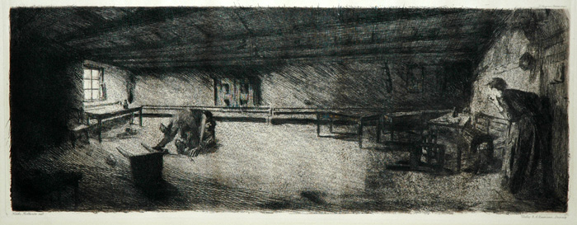
“Scene From Germinal” -1892 Based on a novel that deals with the hardships facing the middle class.

Slide 4
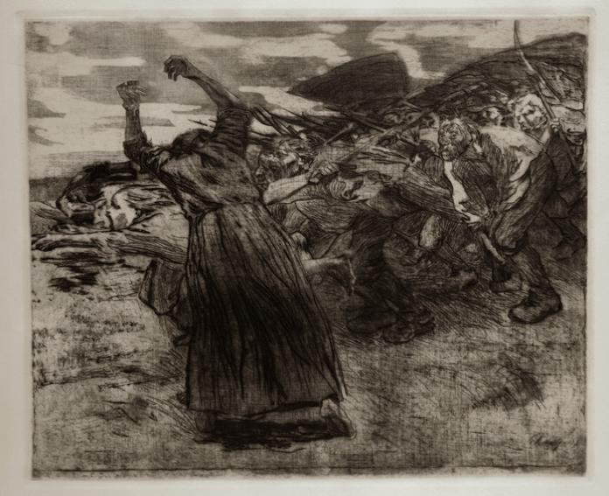
“Charge” -1902 Peasant’s War (1524-1525)- Common people wanted the right to rule themselves and abolish the class system.

Slide 5
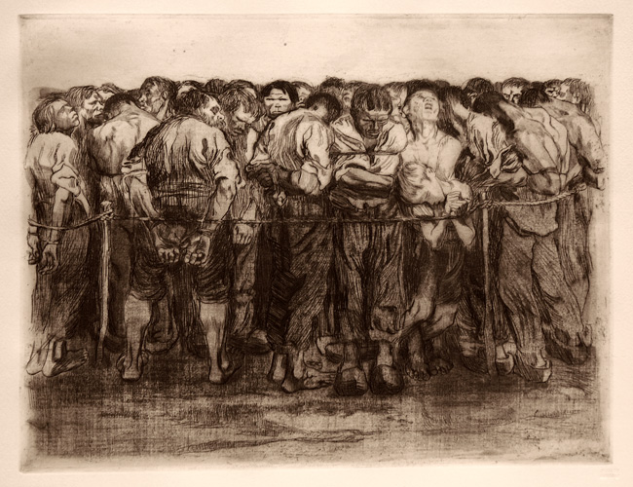
“Prisoners” -1908 (Peasant’s War Series)

Slide 6
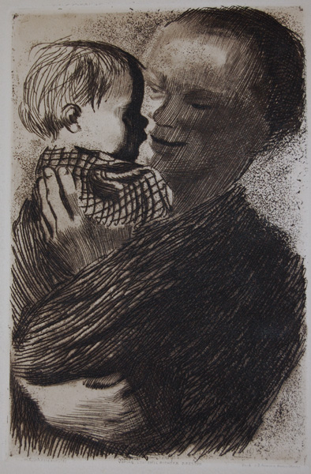
“Mother With Child” -1910

Slide 7
Later Life
"There has been enough of dying! Let not another man fall!“
Husband died in 1940, and her grandson, two years later in World War 2.
Art was banned by Nazi’s and her home bombed, with many of her works being lost.
Kollwitz fled the home in which she had lived for 50 years and died just before the end of WW2.

