Slide 1
The Civil War Soldier’s Experience
Music-Recreation and Function

Slide 2
“I don’t think we could have an army without music.”
-Robert E. Lee
1864

Slide 3
Music held meaning beyond recreation and function
Re-indoctrination
Cheer
Sadness
Boost morale
Proclaim righteousness
To help themselves get through the war

Slide 4
M is for Music
“Soldiers marched to the beat of the fife and the drum, or whistled as they stood in line.
Some had tears in their eyes as they sang of home sweet home, and the girls they left behind.” -Bauer

Slide 5
Common Instruments in Camp
Fife-(high pitched flute)
Bugle-often used as a signal of when to get up, go to sleep, eat etc.
Drum-beat used to assist marching regiments.
Confederate and Union Brass Bands-served as a morale booster and motivator during difficult times. Also, an organizing function on the battlefield.
Song-didn’t require extra equipment, provided hours of entertainment during down time.

Slide 6
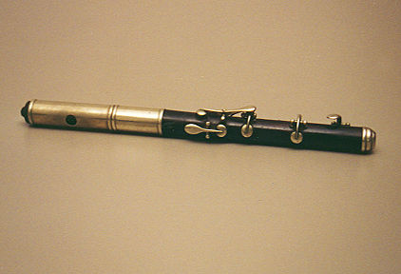
The Fife

Slide 7
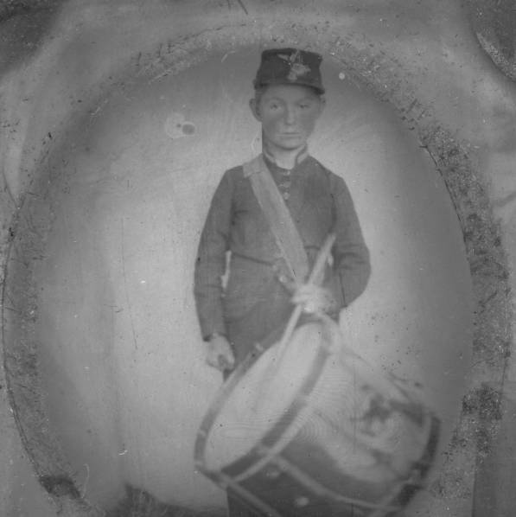
Drummer-
Joseph Fissell
Circleville, Ohio
The youngest Civil War soldier to serve in the Union Army.
He was 11.

Slide 8
Music of the Civil War
“More than ten thousand songs were written by Union and Confederate musicians and poets during the four years of America’s Civil War.
Soldiers in both armies carried song books or “songsters”. These were small volumes containing lyrics of songs, easily carried in knapsacks.
Books were in short supply so soldiers used music to entertain themselves. Often both sides enjoyed similar songs but sometimes they would change the lyrics to reflect their beliefs.

Slide 9
Some Popular Songs
Union
Battle Cry of Freedom
My Maryland
Yankee Doodle
Battle Hymn of the Republic
Versions: John Brown and Jefferson Davis
Confederacy
Dixie
The Bonnie Blue Flag
My Maryland
Version: Ladies they had left behind
The Southern MarseilIaise
The Yellow Rose of Texas

Slide 10
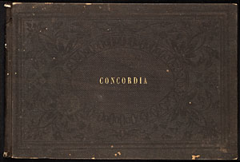
Confederate Songsters
The Concordia : A collection of sacred music, selected and arranged with a variety of selections from the most distinguished composers
Date: 1861
Publisher: Louisville, Kentucky: L. A. Civill and Wood

Slide 11
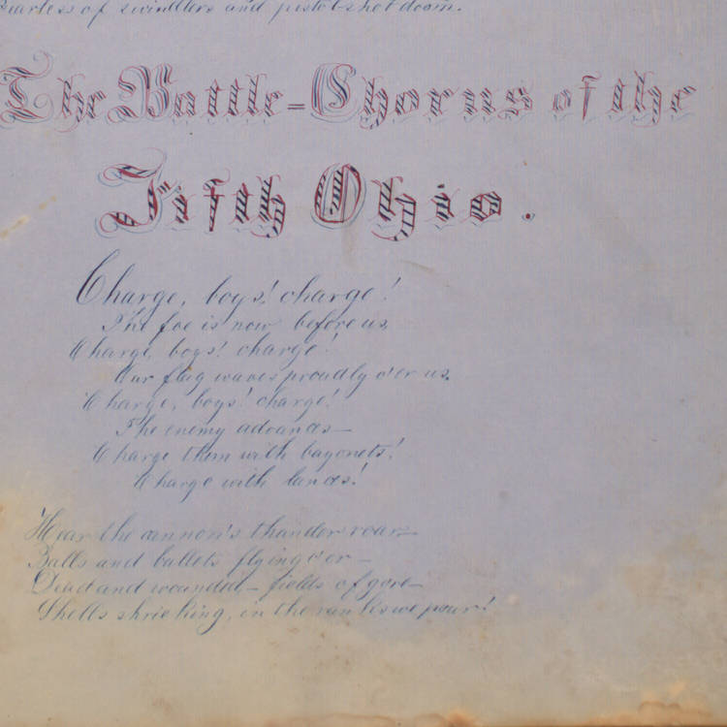
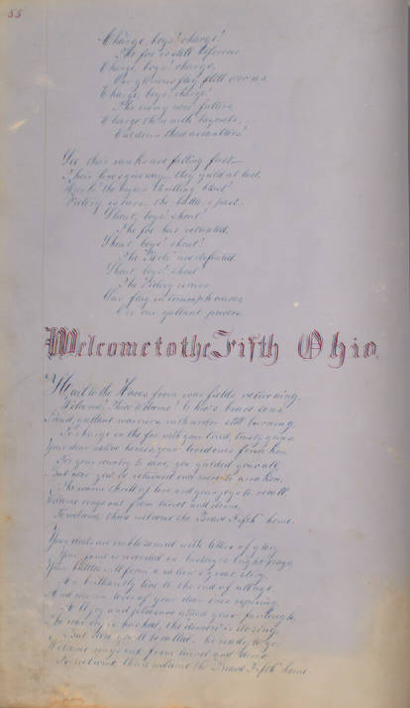
Jessie Gordon-Civil War Songbook
27th Ohio V. I.---Richwood Ohio (Union Co.)
147 pages, 11x17.5

Slide 12
Civil War Bands
By the end of 1861 the Union Army had 618 bands (28,000 musicians) or 1 musician to every 41 soldiers. Confederate numbers were less complete but believed to be similar.
Bands marched with soldiers at the front line.
The band would play specific cadences to signal open fire, cease fire, retreat etc. They could be heard over the din of battle more effectively than yelling.
After the battle, bands would go to the hospital areas to lift the morale of the injured soldiers.

Slide 13
54th Regiment Marching Song
O, give us a flag all free without a slave,
We’ll fight to defend it as our fathers did so brave.
We had a hard road to travel, but our day is coming fast,
For God is for the right, and we have no need to fear--
The Union must be saved by the colored volunteer

Slide 14
Southern Silly Song
Just before the battle, the General hears a row.
He says the Yanks are coming; I hear their rifles now.
He turns around in wonder, what do you think he sees,
The Georgia Militia, eating goober peas.
Peas, peas, peas, peas,
Eating goober peas
Peas, Peas, Peas, Peas,
Eating goober peas.

Slide 15
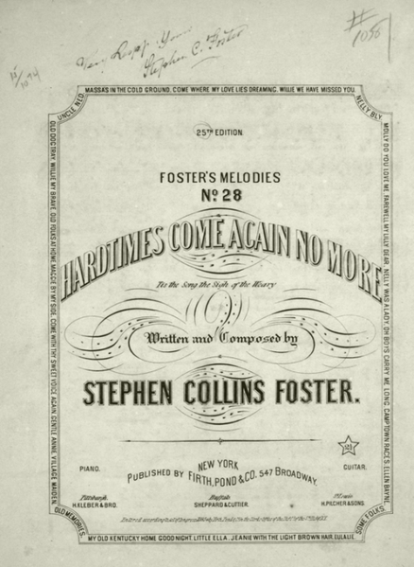
Stephen Foster
“Hard Times Come Again No More”
Published in 1854
Became a war time favorite for both Union and Confederate Soldiers alike.

Slide 16
Defense of Thesis
Point:
Music is prolific regardless of era—Foster’s song that was written in 1854 has been featured in 38 different films and albums since 1975!
Many tunes from this time period are recognizable even if you can’t identify the song.
Point:
Music is a part of humanity, it unites our existence and common experiences.
I hope you have considered the importance that music played on a daily basis for enlisted men during the Civil War.

Slide 17
Bibliography
Bauer, Patricia. “B is for Battle Cry”. Sleeping Bear Press: Chelsea MI. 2009.
Confederate Imprints: Publishing in the Civil War South. University of Alabama Library. http://bindings.lib.ua.edu/gallery/conf_imprints.html
Commager, Henry Steele. Ed. The Civil War Archive: The History of the Civil War in Documents. Tess Press: New York, NY. 2000.
Jesse Gordon Civil War Songbook. 1861-1865. Unpublished Materials (Archives and Manuscripts). Ohio Historical Society. http://www.ohiomemory.org/cdm4/document.php?CISOROOT=/p267401coll32&CISOPTR=2642&REC=4
Joseph Fissell Tintype. 1862-1865. Collection: Joseph Fissell/The Historical Society. Collection Number: AP1480. http://www.ohiopix.org/contentdm-search-results/?cdm-field=CISOSEARCHALL&cdm-mode=all&cdm-page=1&cdm-keywords=Joseph%20Fissell%20Tintype

Slide 18
Bibliography Continued
Lanning, Michael Lee. The Civil War 100. SourceBooks Inc. : Napierville, Illinois. 2006.
McDonald, Archie P. Primary Source Accounts of the Civil War. Enslow Publishers Inc: New Jersey. 2006
Rappaport, Doreen and Verniero, Joan. Untold No More: Stories of the Civil War. Harper Collins: New York, NY. 2006.
Wikipedia Image. Stephen Foster. "Hard Times Come Again No More" (Sheet Music). New York: Firth, Pond & Co. 1854. Public Doman. http://en.wikipedia.org/wiki/File:HardTimesComeAgainNoMore1854.png
Wright, Mike. What They Didn’t Teach You About the Civil War. Presidio Press: California. 1996.

