Slide 1
Canals today

Slide 2
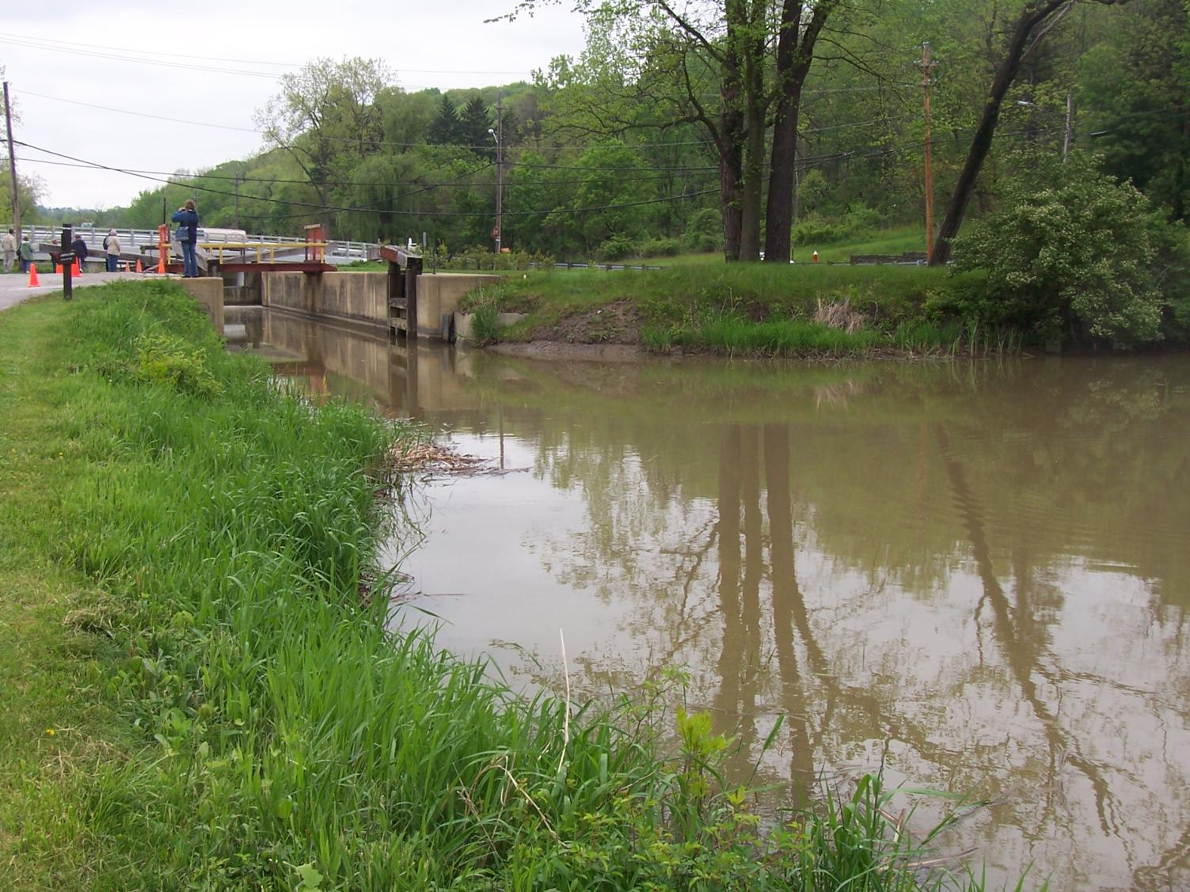

Slide 3
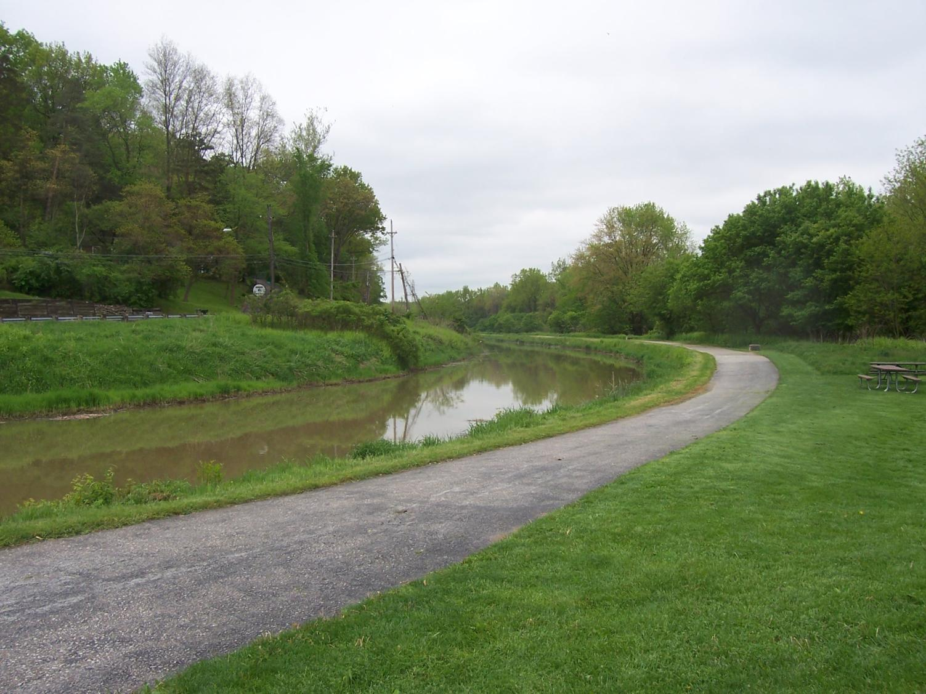

Slide 4
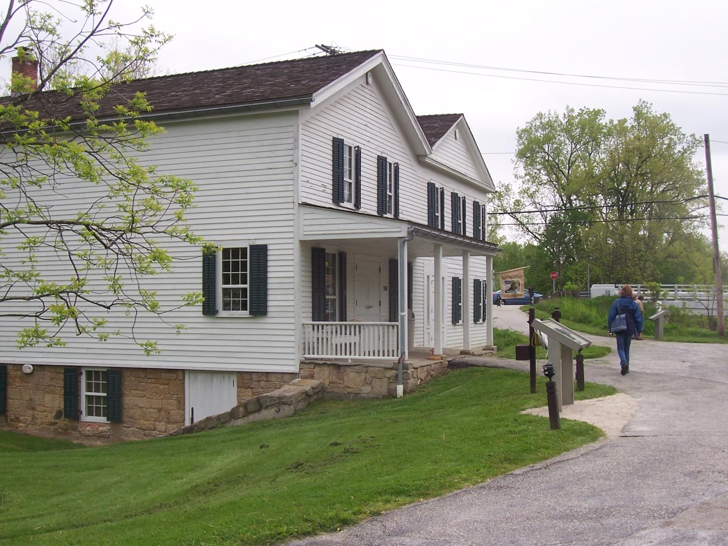

Slide 5
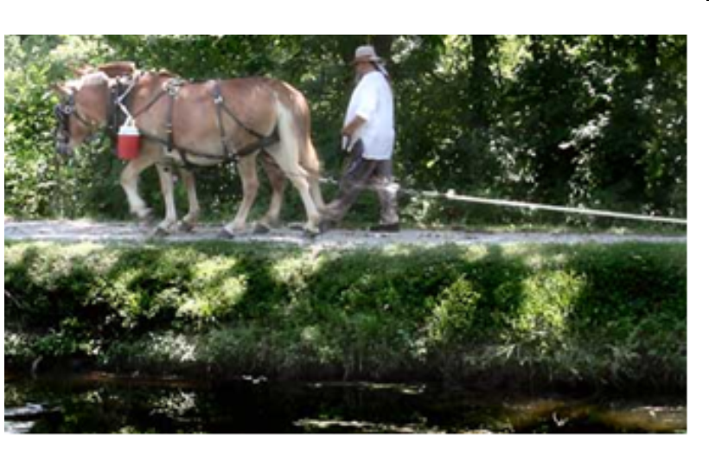

Slide 6
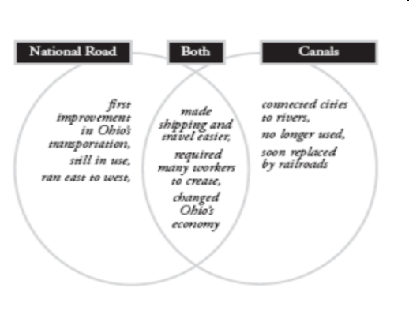

Slide 8
What replaces the canals as the new technology in transportation?

Slide 9
Credits
Betty Condren
Northwestern Elementary School
Janice Kollar
Black River Middle School
Cynthia Twining
Black River Elementary School

