Slide 1
Immigration: from the late 19th Century to the Present
Through the eye of editorial cartoons
Art Lewandowski

Slide 2
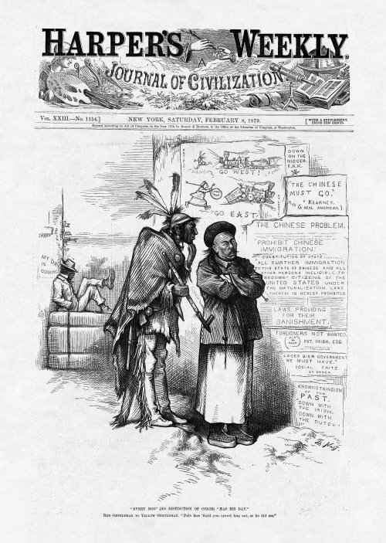
 | Every Dog (No Distinction Of Color) Has His Day
 | February 8, 1879, page 101 |  | view enlargement
 | Red Gentleman to Yellow Gentleman. "Pale face 'fraid you crowd him out , as he did me."
 | This site is brought to you by… Website and all Content © 1998-1999 HarpWeek, LLC Please report problems to webmaster@harpweek.com
Red Gentleman to Yellow Gentleman. "Pale face 'fraid you crowd him out , as he did me."
Source: Thomas Nast from Harpers Weekly February 1879, www.harpweek.com

Slide 3
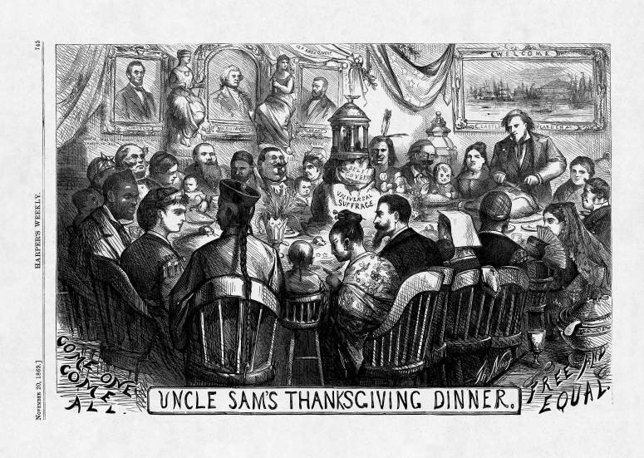
Uncle Sam's Thanksgiving Dinner
 | November 20, 1869, page 745 |  | view small image
Source: Thomas Nast, Harper’s Weekly, November 20, 1869, image from Billy
Ireland cartoon library website

Slide 4
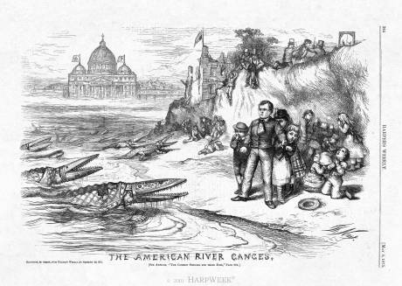
Source: Thomas Nast, Harper’s Weekly, May 1875
http://www.harpweek.com/09cartoon/BrowseByDateCartoon.asp?Month=May&Date=8

Slide 5
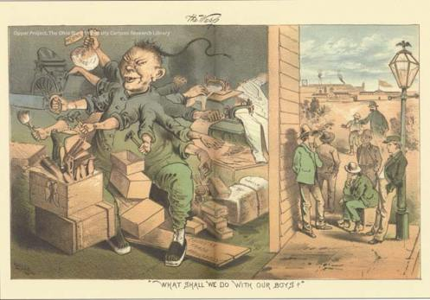
Source: Keller, Frederick, The Wasp 1882, color image from Billy Ireland Cartoon
Library website

Slide 6
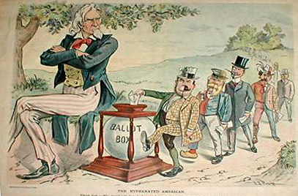
No higher resolution available.
Uncle Sam: “Why should I let these freaks cast whole votes when they are only half Americans?
Source: Puck, 1899, found in Immigration topic file, color image from wikipedia.com

Slide 7
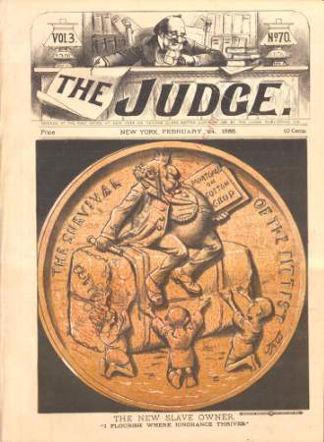
Source: Wales,James Albert, The Judge 1888, found in topic file, color image from
The Billy Ireland Cartoon library website

Slide 8
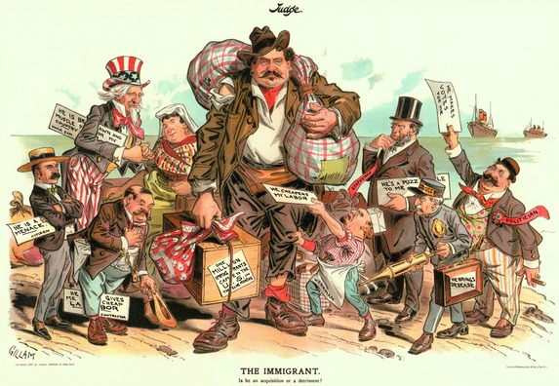
Is he an acquisition or a detriment? Source: Gillam in Judge 1903, found in Immigration
Topic file, color image from Wikipedia.com

Slide 9
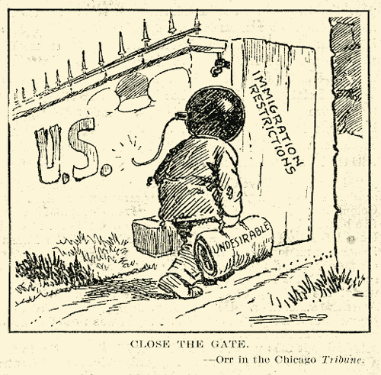
Carey Orr, Chicago Tribune, 1919, Image found at http://nn.wikipedia.org/wiki/Fil:Close_the_gate_-_First_Red_Scare_political_cartoon.jpg

Slide 10
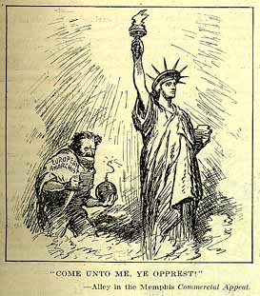
Alley, Literary Digest, Originally from the Memphis Commercial Appeal, July 5 1919, image from: http://newman.baruch.cuny.edu/digital/redscare/htmlcode/CHRON/RS017.HTM

Slide 11
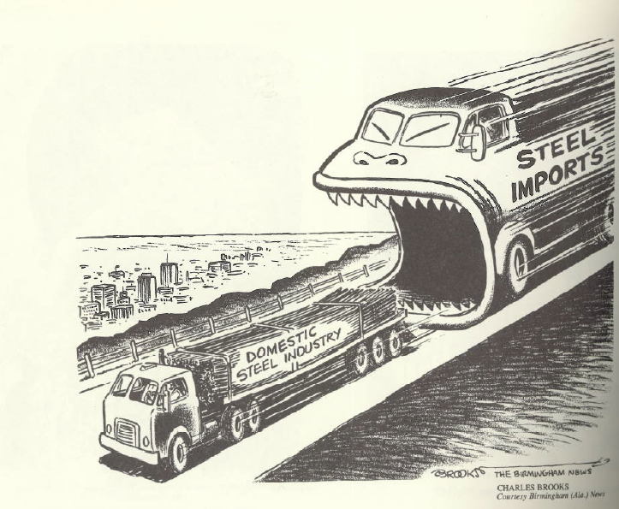
Source: Charles Brooks, Birmingham News 1978, found in The Year’s Best Cartoons
1978, Billy Ireland Cartoon Library and Museum

Slide 12
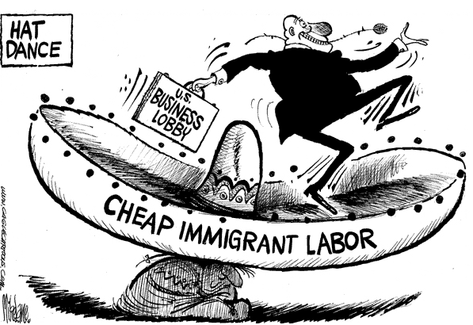
Source: Mike Lane, cagle cartoons circa.2009
http://www.cagle.com/news/Immigration06/

Slide 13
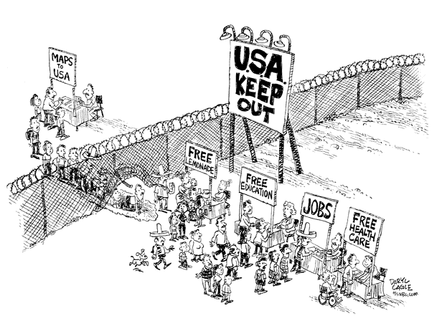
Source: Daryl Cagle, cagle cartoons, circa 2011
http://www.cagle.com/news/Immigration06/

