Slide 1
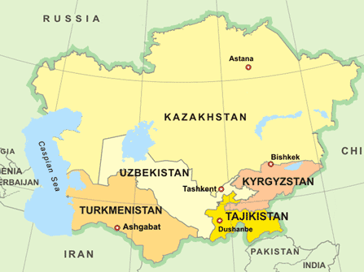
Central Asia in World History
http://www.russia-ukraine-travel.com/image-files/map-central-asia2.gif

Slide 2
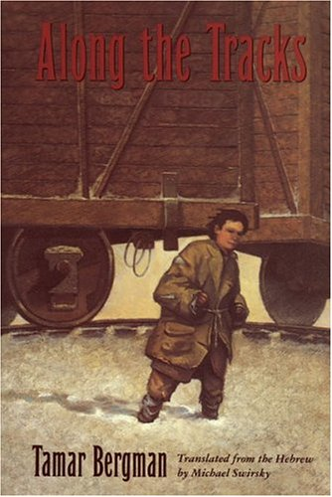
Along the Tracks
by Tamar Bergman

Slide 3
Literature: a gateway into Central Asia Along the Tracks by Tamar Bergman
World War II: Poland on eve of German invasion Holocaust, Judaism
Escape to Ural Mountains, Crimea
Wandering in Uzbekistan: “South to Uzbekistan, everybody’s going there.” besprizoniki: “There was a whole gang of abandoned ones there in Bukhara.” Samarkand, Tashkent, Ferghana Valley, Kokand , Islam, Communism, collective farms, kolkhozi, tche-khana, watermelons! “Since Uzbekistan became a Soviet republic, it’s forbidden to sell girls. It’s not legal to pay a bride price anymore.”

Slide 4
Essential Questions
What can you learn about the people, geography, history, culture, natural environment, and issues (social, political, environmental, etc.) through this novel?
How does this setting define/challenge/change the protagonist?
How can you share what you have learned about this culture and the protagonist’s experience in it?
Students as collaborators, teaching and learning from each other.

Slide 5
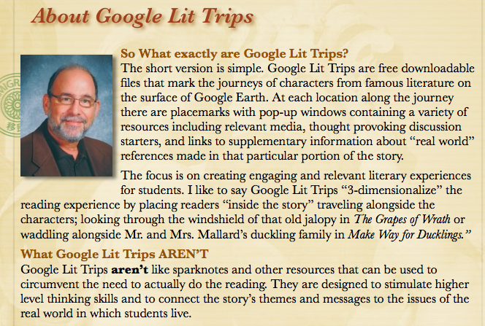
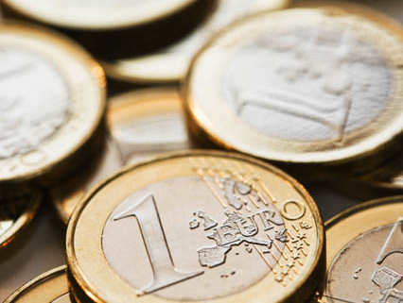
http://www.googlelittrips.org/

Slide 6
Literature Circle discussions and Google Earth activity
Trace the journey of the protagonist using Google Earth.
Extract references to the country’s culture, history, geography, environment, etc. from the day’s reading assignment.
For each reading assignment, create a placemarker that illustrates and informs your peers about the topic you have chosen. How does this topic play a role in the plot of that reading assignment? Include graphics, video when possible, and information from research.

Slide 7
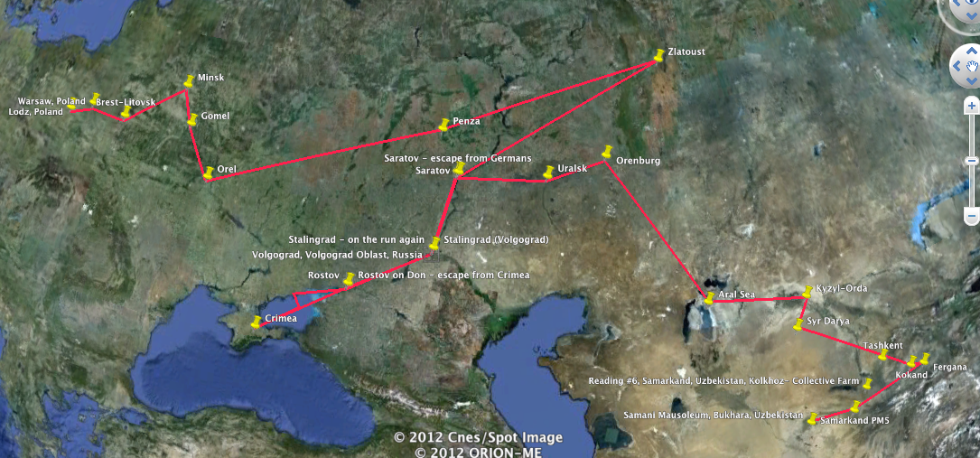

Slide 8
Extension of Project: Preliminary Plan Google Earth Introduction TO UZBEKISTAN Additional resource: Prokudin-Gorskii collection of photographs from Ukbekistan (Library of Congress)
Geography: Describe these geographical features. How do they affect life in Uzbekistan?
Aral Sea (Aral Sea THEN and NOW)
Syr Darya, Amu Darya
Kyzul Kum Desert
Fergana Valley
Tien Shan Mountains

Slide 9
Who were Movers and Shakers in Uzbekistan history? What lasting impact did they have?
Alexander the Great
Chinggis Khan
Tamerlane
Babur

Slide 10
Local Boy Legends: Who are they? What did they achieve? How did they contribute to their society? How have we benefitted from their work?
al Khorezmi (from Khwarazm - now in Uzbekistan)
Ibn Sina (from Kharmaithen near Bukhara)
al Buruni (from Kath, Khwarazm)
Mirzo Ulugbek (observatory in Samarkand

Slide 11
Historical Landmarks in Uzbekistan: When were these landmarks built? Why? By/For whom? Why are they remarkable?
Registan - Samarkan
Ulugbek’s observatory - Samarkan
Amir Timur Museum and Monument -Tashkent
Samani Mausoleum - Bukhara

Slide 12
Other possible topics for introductory Google Earth topics:
Religion in Uzbekistan
The People of Uzbekistan (ethnicities, languages, vocations, education, etc.
Cultural practices in Uzbekistan

