Slide 1
Why shopping is dangerous or Do not waste!
This is the start of a new chapter following our chapter on the Industrial Revolution starting in America.
Show shirtwaists from Fashion2Fiber.osu.edu

Slide 2
Announcement:
There will be a fire drill today with some special changes.

Slide 3
Vocabulary:
Please refer to some vocabulary from our previous chapter.

Slide 4
Rules for fire drill today:
The doors will be locked.
The windows will be locked.

Slide 5
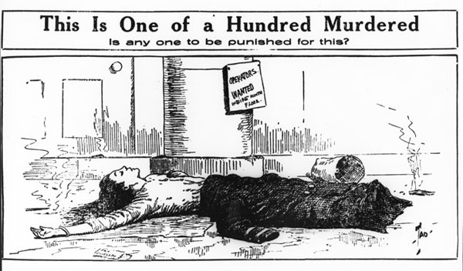
Editorial Cartoon, primary source!

Slide 6
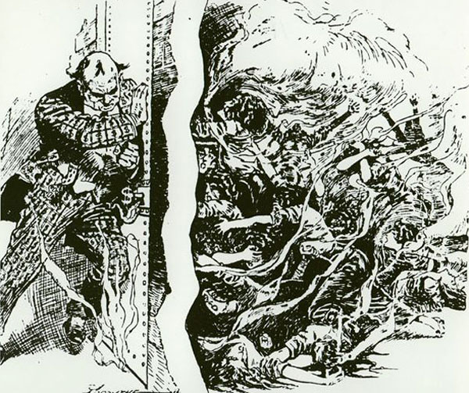
Editorial Cartoon #2, you know it! Primary Source.

Slide 7
New Vocabulary
Vocabulary will be introduced in context sentences.

Slide 8
Project-based chapter:
Creation of a baseball-card type info card on an 4.25 x 5.5 card stock.
A format will be given.
Use of the cornell.edu/trianglefire/ website to begin project
2 more websites will need to be cited for project

Slide 9
Assignments for this chapter/project:
2 spiral questioning worksheets.
3 primary source worksheets, one of which must be death certificate.
A map with birth, death, work place, and route taken to arrive in America.
Narrative @ selected individual from fire.
A death epitaph to place on tombstone/grave marker.
Possible spreadsheet compiled of individual from fire.

Slide 10
Results of projects:
Discuss how changes were made in factories, working conditions, and worker’s treatment.

Slide 11
Standards:
Production & Distribution of Writing:
6. Use technology, including the internet to produce, publish, and update individual or shared writing products, taking advantage of technology’s capacity to link to other information and to display information flexibly and dynamically.
Research to Build & Present Knowledge:
7. Conduct short as well as more sustained research projects to answer a question or solve a problem, narrow or broaden the inquiry when appropriate; synthesize multiple sources on the subject, demonstrating understanding of the subject under investigation.
8. Gather relevant information from multiple authoritative print and digital sources, using advanced searches effectively; assess the usefulness of each source in answering the research question; integrate information into the text selectively to maintain the flow of ideas, avoiding plagiarism and following a standard format for citation.
9. Draw evidence from informational texts to support analysis, reflection, and research.

